Slide 1


A PROPOSAL TO INVESTIGATE ENGINEERING SOLUTIONS TO REDUCE THE URBAN AREA WILD BOAR POPULATION NEAR HEKİMKÖY COMPLEX, TÜRKBÜKÜ, BODRUM
Name: Yasemin Akın
School ID: 22101782
Class: ENG 401 004
Instructor: Marlene Denice Elwell

Slide 2
Contents
1.0 INTRODUCTION
2.0 PROBLEM DEFINITION
3.0 PROPOSED SOLUTIONS
4.0 CRITERIA FOR ASSESSING SOLUTIONS
5.0 PROPOSED RESEARCH METHODOLOGY
6.0 REFERENCES

Slide 3

1.0 Introduction

Slide 4
1.0 Introduction
1.1 PROBLEM:
Nature of the interaction between humans and wildlife has changed in urban and suburban environments [1].
An example of this shift is the increase in urban area wild boar population [2].

Slide 5
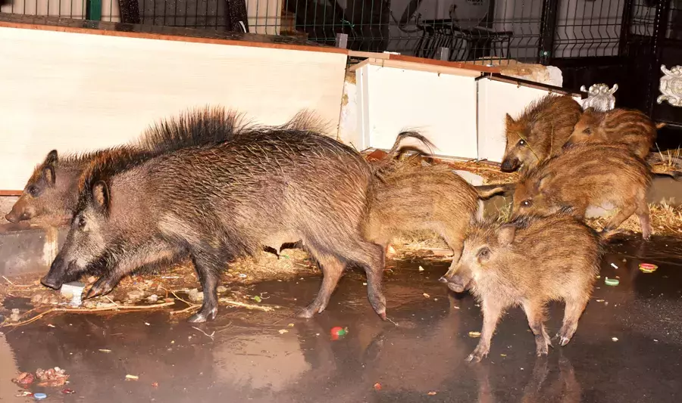
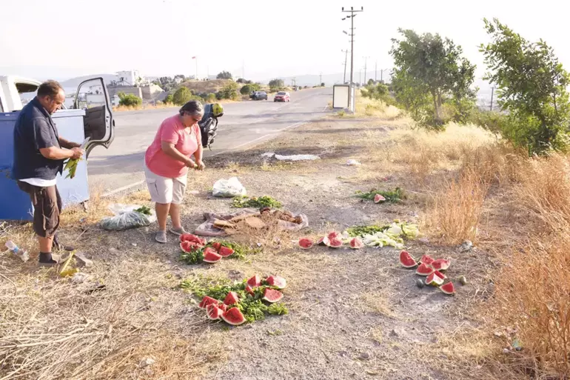
1.0 Introduction
1.1 PROBLEM:
Spread of wild boars into human-populated areas has created an alarming situation
Simultaneous accommodation of wild boars and humans in the same environment poses serious threats to human safety and property [3], [4].
Fig. 1: Wild Boars in Hekimköy Complex [5]
Fig. 2: Residents Feeding Wild Boars Outside of the Complex to Keep Them Away [5]

Slide 6
1.0 Introduction
1.2 PROBLEM’S NEGATIVE IMPACTS:
Causing traffic accidents on dark roads at night
Causing pollution by knocking over garbage bins [5]
Carrying diseases [6]
Attacking to and injuring the residents of the site

Slide 7
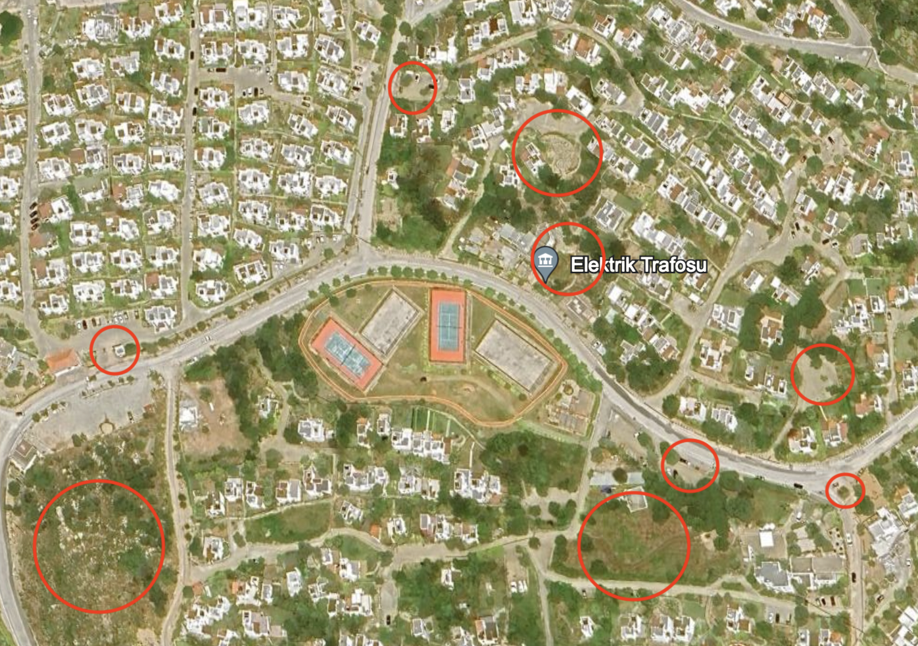
1.0 Introduction
1.3 PILOT STUDY AREA (PSA):
Hekimköy Complex, Türkbükü, Bodrum
Areas marked with red circles represent bush or garbage collection areas, that is, areas where wild boars are abundant.
Fig. 3: Bird’s Eye View of Hekimköy Complex [7]

Slide 8
1.0 Introduction
1.4 STUDY’S PURPOSE, IMPACT AND SIGNIFICANCE:
Reduce the wild boar population within the Hekimköy Complex with the three proposed engineering solutions
PURPOSE
Implementing wild boar-deterring systems throughout the complex upon detecting wild boar presence in the complex, adding an extra layer of security for residents against wild boars
IMPACT
Study’s potential to generate solutions that can be adapted to all regions facing similar disturbances caused by wildlife, regardless of the type of animal species
SIGNIFICANCE

Slide 9
1.0 Introduction
PROPOSED SOLUTIONS
Kinect-Based Deterrent System with an Odor-Repellent
Machine Learning-Based Acoustic Deterrent System
Sensor and Artificial Intelligence-Based Visual Deterrent System

Slide 10
1.0 Introduction
CRITERIA
Feasibility
Monetary Cost
Environmental Safety Impact

Slide 11
1.0 Introduction
METHODOLOGY
Literature Review
Market Research
Field Observation

Slide 12

2.0 Problem definition

Slide 13
2.0 Problem defınıtıon
2.1 PROBLEM:
Cause traffic accidents
Damages to public infrastructure, parks, and private gardens [7] in the Hekimköy Complex.
Raid rubbish bins and containers, creating an irritant to residents.
Transmit diseases to pets and humans [8]
Pose a physical threat to people [4]

Slide 14
2.0 Problem defınıtıon
2.1 PROBLEM:
Overall, wild boars are creating an unsafe environment for outdoor activities within the community [9].

Slide 15
2.0 Problem defınıtıon
2.2 ROOT CAUSES:
2.1.1 Easy Access to Food and Water [10]: in the forms of food wastes, vegetables, fruits
2.1.2 Insufficient Hunting Pressure [11]: lack of lethal resources because of overpopulation
2.1.3 Expanding Urbanization into Forested Areas Occupied by Wild Boars [12]

Slide 16
2.0 Problem defınıtıon
2.3 PROBLEM SCOPE:
Who: Hekimköy Complex residents
What: Wild boar intrusion into urban areas through Hekimköy Complex
When: Although the problem continues at all times of the year, its negative impacts increase in the summertime because of the increase in population in PSA due to summer holiday migrations [13].
Where: Hekimköy Complex, Türkbükü, Bodrum
Why: Increasing wild boar and human interactions lead to conflicts.
How: Causing car accidents, carrying diseases, damaging properties, creating pollution, and giving physical harm to people [7]

Slide 17

3.0 Proposed solutions

Slide 18
3.0 Proposed solutıons
Three engineering solutions are proposed to address the problem:
3.1 Kinect-Based Deterrent System with an Odor-Repellent
3.2 Machine Learning-Based Acoustic Deterrent System
3.3 Sensor and Artificial Intelligence-Based Visual Deterrent System

Slide 19
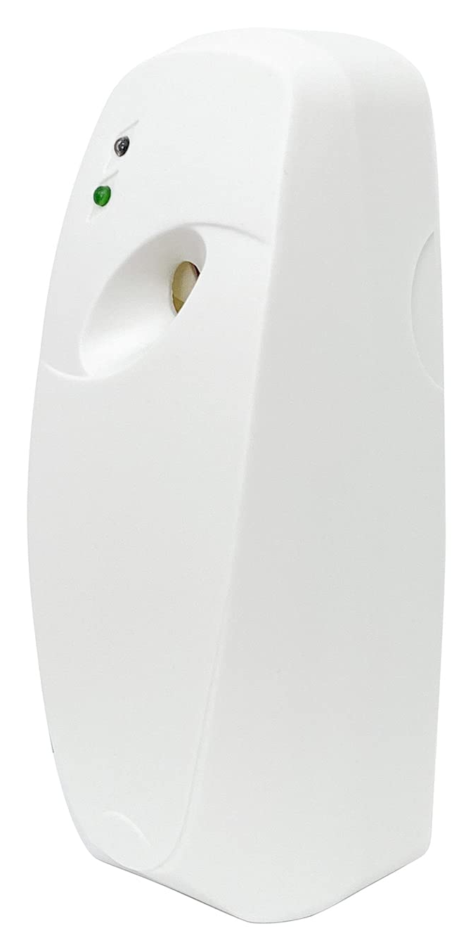
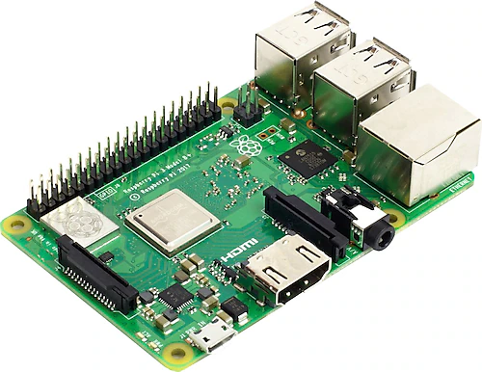
3.0 Proposed solutıons
3.1 KINECT-BASED DETERRENT SYSTEM WITH AN ODOR-REPELLENT
The system will consist of three pieces of hardware: a Kinect camera, a control unit, and an odor dispenser.
Fig. 5: Microcontroller [14]
Fig. 6: Odor Dispenser[15]

Slide 20
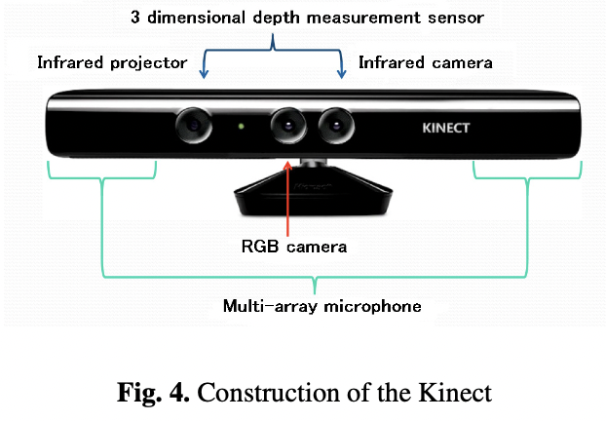
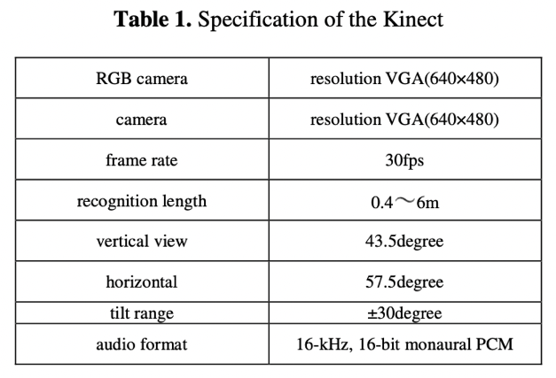
3.0 Proposed solutıons
3.1 KINECT-BASED DETERRENT SYSTEM WITH AN ODOR-REPELLENT
About the Kinect Camera:
“Kinect for Xbox” is a motion-sensing device usually used for gaming [16].
Kinect can create a 3D depth map of its surroundings, allowing it to track the position and movements of objects. Therefore, used for depth-sensing and motion-tracking systems applications [17].
Kinect will be repurposed in this context as an efficient automatic capturing device.
Fig. 4: Construction of the Kinect [18]
Table 1: Specification of the Kinect [18]

Slide 21
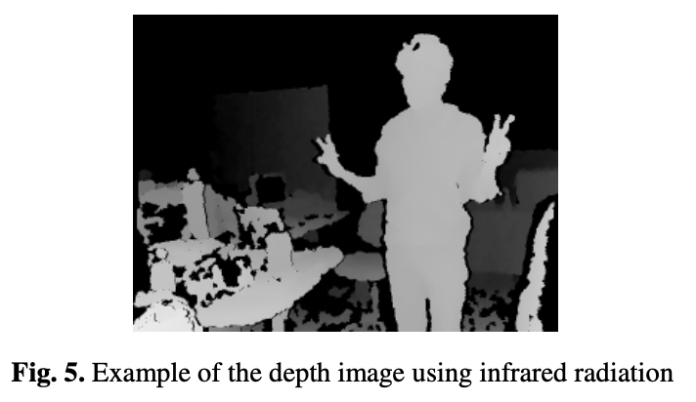
3.0 Proposed solutıons
3.1 KINECT-BASED DETERRENT SYSTEM WITH AN ODOR-REPELLENT
Phase 1 - Image Acquisition:
1. Obtain distance information using Kinect’s infrared projection and camera
2. Kinect uses distance information to create a depth image of the object
Fig. 7: Example of the Depth Image Using Infrared Radiation [18]

Slide 22
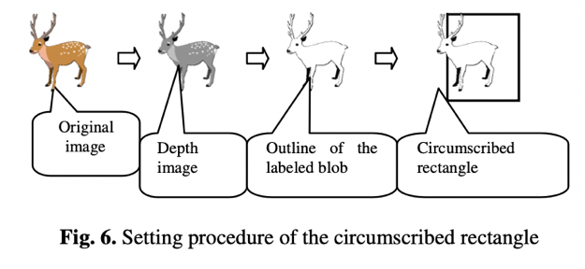
3.0 Proposed solutıons
3.1 KINECT-BASED DETERRENT SYSTEM WITH AN ODOR-REPELLENT
Phase 2 - Detection:
1. Blob analysis by using the shape and size of the object is applied to the depth image, which is an analysis method for object detection [17].
2. Shape and size resemblance of the animals may mislead blob analysis so an extra layer of motion detection will be applied by utilizing the optical flow method on the depth image [18].
Fig. 8: Setting Procedure of the Circumscribed Rectangle [18]

Slide 23
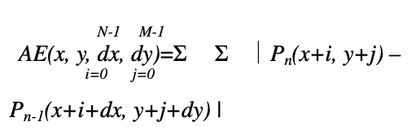
3.0 Proposed solutıons
3.1 KINECT-BASED DETERRENT SYSTEM WITH AN ODOR-REPELLENT
Phase 3 - Odor-Repellent Secretion:
1. Signal identification
2. Control unit, programmable logic controller (PLC), interprets the signal
3. Communication with odor-repellent dispenser
4. Release of “Wildschwein-StoppÒ” [19] from the dispenser
Fig. 9: Mathematical Description of Optical Flow Method (Here, AE is the block matching value on the block (N×M), P is the frame, and dx and dy denote motion vectors.) [18]

Slide 24
3.0 Proposed solutıons
3.1 KINECT-BASED DETERRENT SYSTEM WITH AN ODOR-REPELLENT
Where to Construct Systems?
Areas with a high concentration of wild boar sightings within PSA [16], [20]:
Sides of garbage bins
Garbage collection areas
Overgrown areas throughout the complex

Slide 25
3.0 Proposed solutıons
3.2 MACHINE LEARNING-BASED ACOUSTIC DETERRENT SYSTEM
Components of the Solution:
Infrared Night Vision Camera [21]
Raspberry Pi (Rpi) Microcontroller [22]
Python OpenCV Library [23]
Machine Learning (ML) Model Built on the Convolutional Neural Network (CNN) Architecture [24], [25]
Ultrasonic Frequency Generator [24], [26]
Amplifier [24] (Occasionally)

Slide 26
3.0 Proposed solutıons
3.2 MACHINE LEARNING-BASED ACOUSTIC DETERRENT SYSTEM
Camera continuously records the video of its surroundings.
Rpi captures frames at some rate.
The Python OpenCV library processes the frames to prepare them for the detection step [26].
Image recognition is performed using a Convolutional Neural Network (CNN) machine learning model, trained with a dataset of wild boar images for accurate identification [27], [28].
Rpi sends a signal to an ultrasonic frequency generator upon identifying wild boars.
The ultrasonic repellent produces frequencies that will annoy wild boars, within the range audible to wild boars but not humans [24], [29].

Slide 27
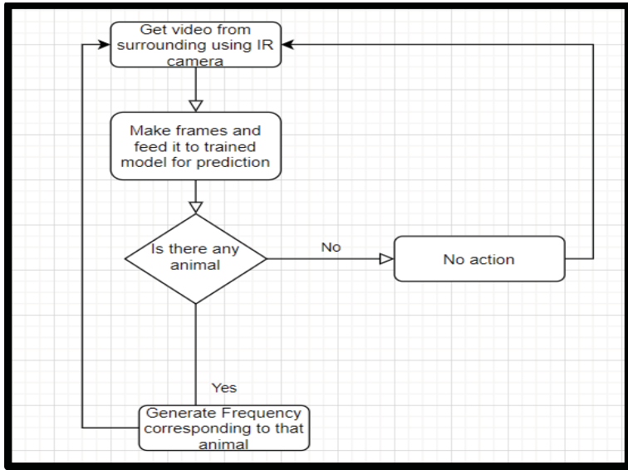
3.0 Proposed solutıons
3.2 MACHINE LEARNING-BASED ACOUSTIC DETERRENT SYSTEM
Fig. 10: Network Diagram of the Proposed Solution [24]

Slide 28
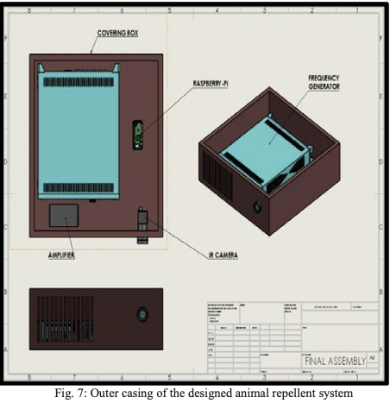
3.0 Proposed solutıons
3.2 MACHINE LEARNING-BASED ACOUSTIC DETERRENT SYSTEM
Based on the sizes of all hardware components, an outer casing will be designed to hold and protect the hardware [24], [30].
This casing can then be placed over streetlights in the PSA, especially near rubbish collection areas, rubbish bins, and vacant bushland [25].
Fig. 11: Outer Casing of the Designed Animal Repellent System [24]

Slide 29
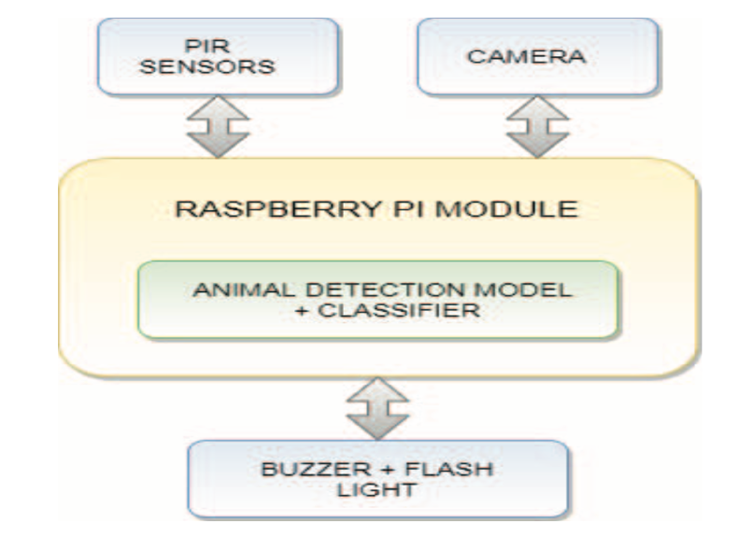
3.0 Proposed solutıons
3.3 SENSOR AND ARTIFICIAL INTELLIGENCE-BASED VISUAL DETERRENT SYSTEM
Components of the System [31]:
Passive Infrared Motion (PIR) Sensors (to sense warm objects around)
Camera
Rpi Microcontroller
Flashlights
FLASHLIGHT
Fig. 12: Architecture Block Diagram for Proposed System [31]

Slide 30
3.0 Proposed solutıons
3.3 SENSOR AND ARTIFICIAL INTELLIGENCE-BASED VISUAL DETERRENT SYSTEM
PIR sensors are placed where wild boars are frequently observed.
PIR sensors detect motion by sensing variations in infrared radiation and can identify warm objects in their field of vision.
When a large, warm object like a wild boar enters the sensor's view, it triggers motion detection.
Camera records live streaming when motion is detected and stores the video on the Rpi.
The YOLO V3 algorithm is used for animal species identification in the detection phase.
YOLO V3 predicts detected object classes and bounding boxes within a single algorithm pass.
If wild boars are detected, the system activates flashlights to deter them.
The flashing lights blink irregularly to annoy and guide the wild boar away from the urban area without causing harm.

Slide 31
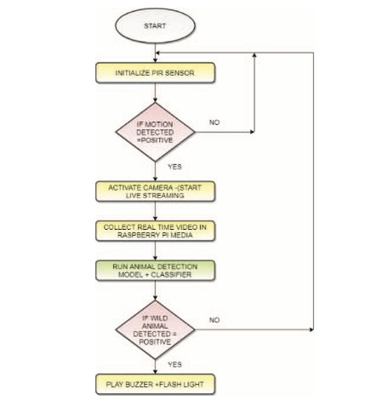
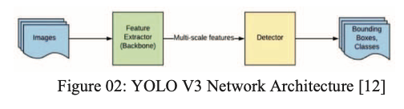
3.0 Proposed solutıons
3.3 SENSOR AND ARTIFICIAL INTELLIGENCE-BASED VISUAL DETERRENT SYSTEM
Fig. 13: YOLO V3 Network Architecture [31]
Fig. 14: Flow Chart for Proposed System [31]

Slide 32

4.0 criteria for assessing solutions

Slide 33
4.0 Criteria for Assessing Solutions
The engineering solutions will be assessed against three criteria:
4.1 Feasibility (35%): The solutions' applicability, practicality, and acceptability affect their possibility of being used in real life.
4.2 Monetary Cost (35%): The monetary costs of the products affect their possibility of being used in real life because they must fit the budget
4.3 Environmental Safety Impact (30%): For the solutions to be applied, the deterrents that are used in the systems must not harm the environment.

Slide 34
4.0 Criteria for Assessing Solutions
4.1 FEASIBILITY
The solutions’ feasibility [32] will be determined by the following:
Kinect-Based Deterrent System with an Odor-Repellent | Machine Learning-Based Acoustic Deterrent System | Sensor and Artificial Intelligence-Based Visual Deterrent System
Verifying the system’s operational functionality [18] Evaluating the time and labor required for the system’s construction [20] Assessing the system installation locations to avoid disturbing PSA residents [34] | Checking the performance of the organization [24], [25] Estimating the amount of time and work needed to build the structure [26] | Controlling the functionality of the system’s operation [31], [33] Calculating how much time and work will be needed to build the organization [33] To prevent disturbing PSA inhabitants, the system installation locations are evaluated [34]
Notes:
The feasibility of the solutions will be assessed by evaluating their operational functionality for applicability, time and labor requirements for construction for practicality and the availability of installation areas that will not disturb Hekimköy residents for acceptability.

Slide 35
4.0 Criteria for Assessing Solutions
4.2 MONETARY COST
The solutions’ monetary cost [35] will be determined by the following:
Kinect-Based Deterrent System with an Odor-Repellent | Machine Learning-Based Acoustic Deterrent System | Sensor and Artificial Intelligence-Based Visual Deterrent System
Cost of acquiring hardware components and the required software [36] Maintaining optimal allocation of financial resources of PSA [37] Ongoing sustainability costs [19] | The price of purchasing the necessary software and hardware components [28] Preserving the best possible distribution of PSA’s financial resources Continual expenses for sustainability [38] | Expenses of purchasing important hardware and software components[39]. Keeping PSA’s financial resources distributed as efficiently as possible [40]. Frequent expenses for sustainability [41]
Notes:
Solutions will be assessed against monetary cost criterion by calculating the costs of the systems, for both construction and sustainability. And also available financial resources will be assessed here too.

Slide 36
4.0 Criteria for Assessing Solutions
4.3 ENVIRONMENTAL SAFETY IMPACT
The solutions’ environmental safety impact [38] will be determined by the following:
Kinect-Based Deterrent System with an Odor-Repellent | Machine Learning-Based Acoustic Deterrent System | Sensor and Artificial Intelligence-Based Visual Deterrent System
Whether the odor-repellent is harmful to the environment [22], [23] | Whether the ultrasonic frequency range to be used as an acoustic deterrent is harmful to other living organisms [30], [42] | Whether the use of visual repellent, flashlight, is harmful to other animals [22], [23], [43]
Notes:
The environmental safety impacts of the solutions will be assessed by evaluating the percentage of possible harm that may come from the repellent elements used in each solution

Slide 37

5.0 proposed research methodology

Slide 38
5.0 Proposed Research Methodology
To assess the engineering solutions with the criteria, three methods will be used:
5.1 Literature Review
5.2 Market Research
5.3 Field Observation

Slide 39
5.0 Proposed Research Methodology
5.1 LITERATURE REVIEW
All proposed solutions will be evaluated against all criteria by the literature review [44], [45] method:
 | Kinect-Based Deterrent System with an Odor-Repellent | Machine Learning-Based Acoustic Deterrent System | Sensor and Artificial Intelligence-Based Visual Deterrent System
Literature Review | Feasibility [18], [20], [39] Monetary Cost [19] Environmental Safety Impact [22], [23] | Feasibility [24], [25], [26] Monetary Cost [28], [40] Environmental Safety Impact [30], [42] | Feasibility [31], [32], [33] Monetary Cost [41] Environmental Safety Impact [43]

Slide 40
5.0 Proposed Research Methodology
5.2 MARKET RESEARCH
All proposed solutions will be evaluated against monetary cost criterion by the market research [46] method:
 | Kinect-Based Deterrent System with an Odor-Repellent | Machine Learning-Based Acoustic Deterrent System | Sensor and Artificial Intelligence-Based Visual Deterrent System
Market Research | Monetary Cost | Monetary Cost [40] | Monetary Cost

Slide 41
5.0 Proposed Research Methodology
5.3 FIELD OBSERVATION
All proposed solutions will be evaluated against feasibility and environmental safety impact criteria by the field observation [47] method:
 | Kinect-Based Deterrent System with an Odor-Repellent | Machine Learning-Based Acoustic Deterrent System | Sensor and Artificial Intelligence-Based Visual Deterrent System
Field Observation | Feasibility Environmental Safety Impact | Feasibility Environmental Safety Impact | Feasibility Environmental Safety Impact

Slide 42

6.0 References

Slide 43
6.0 References
[1] C. Conejero, R. Castillo-Contreras, C. González-Crespo, E. Serrano, G. Mentaberre, S. Lavín, and J. R. López-Olvera, "Past experiences drive citizen perception of wild boar in urban areas," Mammalian Biology: Zeitschrift für Säugetierkunde, vol. 96, pp. 68-72, May 2019. [Online]. Available: Springer Nature Journals, https://www.springernature.com/gp/products/journals. [Accessed Oct. 28, 2023].
[2] C. Hunold and M. Mazuchowski, "Human-wildlife coexistence in urban wildlife management: Insights from nonlethal predator management and rodenticide bans," Animals, vol. 10, no. 11, pp. 1-15, November 2020. [Online]. Available: Scopus, https://www.scopus.com/search/form.uri?display=basic#basic. [Accessed Oct. 28, 2023].
[3] S. Tampakis, V. Andrea, T. Panagopoulos, P. Karanikola, R. Gkarmiri, and T. Georgoula, "Managing the Conflict of Human-Wildlife Coexistence: A Community-Based Approach," Land, vol. 12, no. 832, p. 832+, April 2023. [Online]. Available: Scopus, https://www.scopus.com/search/form.uri?display=basic#basic. [Accessed Oct. 28, 2023].
[4] S. Cahill, F. Llimona, L. Cabañeros, and F. Calomardo, "Characteristics of wild boar (Sus scrofa) habituation to urban areas in the Collserola Natural Park (Barcelona) and comparison with other locations," Animal Biodiversity and Conservation, vol. 35, no. 2, pp. 221-233, 2012. [Online]. Available: Directory of Open Access Journals, https://doaj.org. [Accessed Oct. 28, 2023].
[5] Anadolu Agency, “Bodrum locals feeding wild boars to keep them in the forest,” Hürriyet Daily News: Arts & Life, p. 3, Jun. 15, 2018. [Online]. Available: Hürriyet Daily News, https://www.hurriyetdailynews.com. [Accessed Oct. 28, 2023].
[6] H. Albayrak, E. Ozan, and A. Cavunt, "A serological survey of selected pathogens in wild boar (Sus scrofa) in northern Turkey," European Journal of Wildlife Research, vol. 59, no. 6, pp. 893-897, June 2013. [Online]. Available: Springer Nature Journals, https://www.springernature.com/gp/products/journals. [Accessed Oct. 28, 2023].
[7] R. Castillo-Contreras, J. Carvalho, E. Serrano, G. Mentaberre, X. Fernández-Aguilar, A. Colom, C. González-Crespo, S. Lavín, and J. R. López-Olvera, "Urban wild boars prefer fragmented areas with food resources near natural corridors," Science of the Total Environment, vol. 615, pp. 282-288, January 2018. [Online]. Available: ScienceDirect, https://www.sciencedirect.com. [Accessed Oct. 28, 2023].
[8] X. J. Meng, D. S. Lindsay, and N. Sriranganathan, "Wild boars as sources for infectious diseases in livestock and humans," Philosophical Transactions: Biological Sciences, vol. 364, no. 1530, pp. 2697-2707, September 2009. [Online]. Available: JSTOR Journals, https://www.jstor.org. [Accessed Oct. 29, 2023].
[9] T. Ikeda, N. Kuninaga, T. Suzuki, S. Ikushima, and M. Suzuki, "Tourist-wild boar (Sus scrofa) interactions in urban wildlife management," Global Ecology and Conservation, vol. 18, May 2019. [Online]. Available: ScienceDirect, https://www.sciencedirect.com. [Accessed Oct. 28, 2023].
[10] J. Carpio, M. Apollonio, and P. Acevedo, "Wild ungulate overabundance in Europe: contexts, causes, monitoring and management recommendations," Mammal Review, vol. 51, no. 1, pp. 95-108, January 2021. [Online]. Available: OAIster, https://www.oclc.org/en/oaister.html. [Accessed Oct. 28, 2023].

Slide 44
6.0 References
[11] L. Nelli, B. Schehl, R. A. Stewart, D. J. McCafferty, C. Scott, S. Ferguson, and S. MacMillan, "Predicting habitat suitability and connectivity for management and conservation of urban wildlife: A real-time web application for grassland water voles," Journal of Applied Ecology, vol. 59, no. 4, pp. 1072-1085, April 2022. [Online]. Available: Scopus, https://www.scopus.com/search/form.uri?display=basic#basic. [Accessed Oct. 28, 2023].
[12] L. L. Griffin, A. Haigh, K. Conteddu, M. Andaloc, S. Ciuti, and P. McDonnell, "Reducing risky interactions: Identifying barriers to the successful management of human-wildlife conflict in an urban parkland," People and Nature, vol. 4, no. 4, pp. 918-930, August 2022. [Online]. Available: Scopus, https://www.scopus.com/search/form.uri?display=basic#basic. [Accessed Oct. 28, 2023].
[13] C. González-Crespo, B. Martínez-López, C. Conejero, R. Castillo-Contreras, E. Serrano, J. M. López-Martín, S. Lavín, and J. R. López-Olvera, "Predicting human-wildlife interaction in urban environments through agent-based models," Landscape and Urban Planning, vol. 240, no. 104878, December 2023. [Online]. Available: ScienceDirect, https://www.sciencedirect.com. [Accessed Oct. 28, 2023].
[14] International Business Times, “A look at the Xbox One Kinect: what it does and what the Xbox One can do without it,” International Business Times, Nov. 25, 2013. [Online]. Available: Scopus, https://www.scopus.com/search/form.uri?display=basic#basic. [Accessed Oct. 28, 2023].
[15] International Business Times, “Xbox One: what’s up for developers, gamers and the Kinect,” International Business Times, Jun. 19, 2014. [Online]. Available: Scopus, https://www.scopus.com/search/form.uri?display=basic#basic. [Accessed Oct. 28, 2023].
[16] J. Wevers, J. Fattebert, J. Casaer, T. Artois, and N. Beenaerts, "Trading fear for food in the Anthropocene: How ungulates cope with human disturbance in a multi-use, suburban ecosystem," Science of the Total Environment, vol. 741, no. 140369, November 2020. [Online]. Available: Scopus, https://www.scopus.com/search/form.uri?display=basic#basic. [Accessed Oct. 28, 2023].
[17] S. Rajkumar, A. Hariharan, S. Girish, and M. Arulmurugan, “An efficient vehicle detection and shadow removal using Gaussian mixture models with blob analysis for machine vision application,” SN Computer Science, vol. 4, no. 5, pp. 450-460, September 2023. [Online]. Available: Scopus, https://www.scopus.com/search/form.uri?display=basic#basic. [Accessed Oct. 28, 2023].
[18] F. Takeda, "Generation method of the trigger signal for the automatic capture system to the harmful animals with intelligent image processing," in Distributed Computing and Artificial Intelligence: Proc. of the 11th Int. Conf. on Advances in Intelligent Systems and Computing, DCAI 2014, 4-6 June 2014, Salamanca, Spain [Online]. Available: Scopus, https://www.scopus.com/search/form.uri?display=basic#basic. [Accessed: Oct. 28, 2023].
[19] T. Kušta, Z. Keken, M. Ježek, and Z. Kůta, "Effectiveness and costs of odor repellents in wildlife-vehicle collisions: A case study in Central Bohemia, Czech Republic," Transportation Research Part D: Transport and Environment, vol. 38, pp. 1-5, July 2015. [Online]. Available: ScienceDirect, https://www.sciencedirect.com. [Accessed Oct. 28, 2023].
[20] M. Bíl, R. Andrášik, T. Bartonička, Z. Křivánková, and J. Sedoník, "An evaluation of odor repellent effectiveness in the prevention of wildlife-vehicle collisions," Journal of Environmental Management, vol. 205, pp. 209-214, January 2018. [Online]. Available: ScienceDirect, https://www.sciencedirect.com. [Accessed Oct. 28, 2023].

Slide 45
6.0 References
[21] S. M. Enosh and N. S. George, "An efficient implementation of protocol operation control unit of FlexRay communication controller," in Proc. of the 2014 1st Int. Conf. on Computational Systems and Communications (ICCSC), 17-18 December 2014, Trivandrum, India [Online]. Available: IEEE Xplore, http://www.ieee.org. [Accessed: 28 Oct. 2023].
[22] Schlageter and D. Haag-Wackernagel, "Evaluation of an odor repellent for protecting crops from wild boar damage," Journal of Pest Science, vol. 85, no. 2, pp. 209-215, June 2012. [Online]. Available: Springer Nature Journals, https://www.springernature.com/gp/products/journals. [Accessed Oct. 28, 2023].
[23] S. Giordano, I. Seitanidis, M. Ojo, D. Adami, and F. Vignoli, "IoT solutions for crop protection against wild animal attacks," in Proc. of the 2018 IEEE Int. Conf. on Environmental Engineering (EE), 12-14 March 2018, Milan, Italy [Online]. Available: IEEE Xplore, http://www.ieee.org. [Accessed: 28 Oct. 2023].
[24] D. Ranparia, G. Singh, A. Rattan, H. Singh, and N. Auluck, "Machine learning-based Acoustic Repellent System for Protecting Crops against Wild Animal Attacks," in Proc. of the 2020 IEEE 15th Int. Conf. on Industrial and Information Systems (ICIIS), 26-28 November 2020, Rupnagar, India [Online]. Available: IEEE Xplore, http://www.ieee.org. [Accessed: 28 Oct. 2023].
[25] M. Dubovečak, E. Dumić, and A. Bernik, “Face detection and recognition using Raspberry PI Computer,” Technical Journal / Tehnicki Glasnik, vol. 17, no. 3, pp. 346-352, September 2023. [Online]. Available: The Belt and Road Initiative Reference Source, https://www.ebsco.com/products/research-databases/belt-and-road-initiative-reference-source [Accessed Oct. 28, 2023].
[26] G. Singh, I. Gupta, J. Singh, and N. Kaur, “Face recognition using open-source computer vision library (OpenCV) with Python,” in Proc. of the 2022 10th Int. Conf. on Reliability, Infocom Technologies and Optimization (Trends and Future Directions) (ICRITO), 13-14 October 2022, Noida, India [Online]. Available: IEEE Xplore, http://www.ieee.org. [Accessed: 28 Oct. 2023].
[27] A. Pradeep, M. Asrorov, and M. Quronboyeva, “Advancement of sign language recognition through technology using Python and OpenCV,” in Proc. of the 2023 7th Int. Multi-Topic ICT Conf. (IMTIC), 10-12 May 2023, Jamshoro, Pakistan [Online]. Available: IEEE Xplore, http://www.ieee.org. [Accessed: 28 Oct. 2023].
[28] A. Shrivastava, M. Chakkaravathy, and M. A. Shah, “A comprehensive analysis of machine learning techniques in biomedical image processing using Convolutional Neural Network,” in Proc of the 2022 5th Int. Conf. on Contemporary Computing and Informatics (IC3I), 14-16 December 2022, Uttar Pradesh, India [Online]. Available: IEEE Xplore, http://www.ieee.org. [Accessed: 28 Oct. 2023].
[29] P. Simard, D. Steinkraus, and J. Platt, "Best practices for convolutional neural networks applied to visual document analysis," in Proc. of the 7th Int. Conf. on Document Analysis and Recognition, 6 August 2003, Edinburgh, UK [Online]. Available: IEEE Xplore, http://www.ieee.org. [Accessed: 28 Oct. 2023].
[30] R. S. Heffner and H. E. Heffner, "Hearing in domestic pigs (Sus scrofa) and goats (Capra hircus)," Hearing Research, vol. 48, no. 3, pp. 231-240, October 1990. [Online]. Available: Scopus, https://www.scopus.com/search/form.uri?display=basic#basic. [Accessed Oct. 28, 2023].

Slide 46
6.0 References
[31] H. D. Patil and N. F. Ansari, "Intrusion detection and repellent system for wild animals using artificial intelligence of things," in Proc. of the 2022 Int. Conf. on Computing, Communication and Power Technology (IC3P), 7-8 January 2022, Visakhapatnam, India [Online]. Available: IEEE Xplore, http://www.ieee.org. [Accessed: 28 Oct. 2023].
[32] J. Andrews, M. Kowsika, A. Vakil, and J. Li, “A motion-induced passive infrared (PIR) sensor for stationary human occupancy detection,” in Proc. of the 2020 IEEE/ION Position, Location and Navigation Symposium (PLANS), 20-23 April 2020, Portland, USA [Online]. Available: IEEE Xplore, http://www.ieee.org. [Accessed: 28 Oct. 2023].
[33] S. Yang, H. Ge, and Q. Li, “Infrared night camouflage target detection algorithm based on improved YOLO v3,” in Proc of the 2022 IEEE 8th Int. Conf. on Computer and Communications (ICCC), 9-12 December 2022, Chengdu, China [Online]. Available: IEEE Xplore, http://www.ieee.org. [Accessed: 28 Oct. 2023].
[34] M. Sharmila F, C. K. Amal Kumar, A. Varsha D, and E. Sarayu, "Animal repellent system for smart farming using AI and Edge Computing," in Proc. of the 2022 8th Int. Conf. on Advanced Computing and Communication Systems (ICACCS), 25-26 March 2022, Coimbatore, India [Online]. Available: IEEE Xplore, http://www.ieee.org. [Accessed: 28 Oct. 2023].
[35] D. Carniato, J. Sereno, J. Vicente, J. A. Blanco, M. Scandura, M. Apollonio, P. Palencia, and P. Acevedo, "Implementing practical methods to estimate the population density of wild boar and other wild mammals: field trials and development of automatic identification," EFSA Supporting Publications, vol. 19, no. 9, pp. 1-48, August 2022. [Online]. Available: Academic Search Ultimate, https://www.ebsco.com/products/research-databases/academic-search-ultimate. [Accessed Oct. 28, 2023].
[36] S. McLeod, “Feasibility studies for novel and complex projects: Principles synthesized through an integrative review,” Project Leadership and Society, vol. 2, December 2022. [Online]. Available: ScienceDirect, https://www.sciencedirect.com. [Accessed Oct. 28, 2023].
[37] X. Wang, Z. Du, Y. Wang, J. Wang, S. Huang, Y. Wang, J. Gu, W. Deng, S. Gilmour, J. Li, and Y. Hao, "Impact and cost-effectiveness of biomedical interventions on adult Hepatitis B elimination in China: A mathematical modeling study," Journal of Epidemiology and Global Health, vol. 13, no. 3, pp. 517-527, June 2023. [Online]. Available: Springer Nature Journals, https://www.springernature.com/gp/products/journals. [Accessed Oct. 28, 2023].
[38] D. W. North, "Engineering a safer world: systems thinking applied to safety," Risk Analysis, vol. 34, no. 2, pp. 391-396, February 2014. [Online]. Available: Science Citation Index Expanded, https://clarivate.com/products/scientific-and-academic-research/research-discovery-and-workflow-solutions/webofscience-platform/web-of-science-core-collection/science-citation-index-expanded/. [Accessed Oct. 28, 2023].
[39] J. Rovira, M. Nadal, M. Schuhmacher, and J. L. Domingo, "Human exposure to trace elements through the skin by direct contact with clothing: Risk assessment," Environmental Research, vol. 140, pp. 308-316, July 2015. [Online]. Available: ScienceDirect, https://www.sciencedirect.com. [Accessed Oct. 28, 2023].
[40] P. C. Lyon, C. Mannaris, M. Gray, R. Carlisle, F. V. Gleeson, D. Cranston, F. Wu, and C. C. Coussios, "Large-volume hyperthermia for safe and cost-effective targeted drug delivery using a clinical ultrasound-guided focused ultrasound device," Ultrasound in Medicine & Biology, vol. 47, no. 4, pp. 982-997, April 2021. [Online]. Available: Scopus, https://www.scopus.com/search/form.uri?display=basic#basic. [Accessed Oct. 28, 2023].

Slide 47
6.0 References
[41] G. M. M. Zarco and V. O. Monroy, "Effectiveness of low-cost deterrents in decreasing livestock predation by felids: a case in Central Mexico," Animal Conservation, vol. 17, no. 4, pp. 371-378, August 2014. [Online]. Available: Academic Search Ultimate, https://www.ebsco.com/products/research-databases/academic-search-ultimate. [Accessed Oct. 28, 2023].
[42] W. L. Nyborg, "Determining risk to subjects: exposure to ultrasound," IRB, vol. 9, no. 3, pp. 1-5, May 1987. [Online]. Available: Scopus, https://www.scopus.com/search/form.uri?display=basic#basic. [Accessed Oct. 28, 2023].
[43] Y. Wang, J. Jian, B. Sun, Y. Wei, D. Pan, J. Cao, and Y. Shen, "Engineering of onsite point-of-care testing of Fe3+ with visual ratiometric fluorescent signals of copper nanoclusters-driven portable smartphone," Sensors and Actuators: B. Chemical, vol. 370, November 2022. [Online]. Available: ScienceDirect, https://www.sciencedirect.com. [Accessed Oct. 28, 2023].
[44] G. Wagner, R. Lukyanenko, and G. Paré, "Artificial intelligence and the conduct of literature reviews," Journal of Information Technology, vol. 37, no. 2, pp. 209-226, June 2022. [Online]. Available: Scopus, https://www.scopus.com/search/form.uri?display=basic#basic. [Accessed Oct. 28, 2023].
[45] K. D. Ward, D. P. Mason, G. Park, and R. Fyall, "Exploring nonprofit advocacy research methods and design: a systematic review of the literature," Nonprofit and Voluntary Sector Quarterly, vol. 52, no. 5, pp. 1210-1231, October 2023. [Online]. Available: Scopus, https://www.scopus.com/search/form.uri?display=basic#basic. [Accessed Oct. 28, 2023].
[46] Wm. J. Gonzenbach and Michael Mitrook, "The market research toolbox: a concise guide for beginners," International Journal of Public Opinion Research, vol. 8, no. 4, pp. 411-412, December 1996. [Online]. Available: Business Source Ultimate, https://www.ebsco.com/products/research-databases/business-source-ultimate. [Accessed Oct. 28, 2023].
[47] C. T. Husbands, "Field research: a sourcebook and field manual R. G. Burgess," The British Journal of Criminology, vol. 23, no. 2, pp. 198–199, April 1983. [Online]. Available: Academic Search Ultimate, https://www.ebsco.com/products/research-databases/academic-search-ultimate. [Accessed Oct. 28, 2023].

Slide 48
Thank you for listening!

